Slide 1
Predicting the impact of pathway regulations on overall survival time of cancer patient.
Lifeline Analytics Crew | Team 12
Karan Raj Bagri
SR No. 23049
M.Tech CDS
karanraj@iisc.ac.in
Parvesh Barak
SR No. 23181
M.Tech (Res) CDS
parveshbarak@iisc.ac.in
Sauma Suvra Majumdar
SR No. 23015
Ph.D IMI
saumasurva@iisc.ac.in
Suved Sanjay Ghanmode
SR No. 23339
M.Tech (Res) CDS
suvedsanjay@iisc.ac.in
November 25, 2023

Slide 2
Agenda
Introduction
Dataset
Dataset Observations
Statistical Methods
Workflow
Results
An Interesting Observation
Conclusion
References

Slide 3
Introduction
Cancer is a large group of diseases that can start in almost any organ or tissue of the body when abnormal cells grow uncontrollably, go beyond their usual boundaries to invade adjoining parts of the body and/or spread to other organs. The latter process is called metastasizing and is a major cause of death from cancer.
Cancer is the second leading cause of death globally, accounting for an estimated 10 million deaths, or 1 in 6 deaths, in 2020. Lung, prostate, colorectal, stomach and liver cancer are the most common types of cancer in men, while breast, colorectal, lung, cervical and thyroid cancer are the most common among women.
A pathway is defined as a set of actions or interactions between genes and their products that results in the formation or change of some component of the system, essential for the correct functioning of a biological system.

Slide 4
Introduction (cont.)
In cancer, the regulation of various cell signalling pathways is often disrupted, leading to uncontrolled cell growth, survival, and invasion. Regulation of the pathways play crucial roles in the development and progression of cancer and is linked to the survival chances of patients.
In this project, we have picked up few cancers, and looked forward to following goals:
Identifying the top up/down regulated pathways for the given cancer type i.e. pathway analysis.
Predicting the overall survival time (with probabilities) for the patients (belonging to that cancer type) using the top 3 up/down regulated pathways.
Analysing the effect of most hazardous pathway on the overall survival time for the patients.

Slide 5
Dataset
The Cancer Genome Atlas (TCGA), a landmark cancer genomics program, molecularly characterized over 20,000 primary cancer and matched normal samples spanning 33 cancer types.
Dataset
TCGA Pan Cancer Dataset
Unit - log2(norm_value+1)
20532 genes (rows) x 11060 samples (columns).
~1.6 GB file size.
Phenotype – Curated clinical data
The dataset highlights four types of carefully curated survival endpoints and recommends the use of the endpoints of Overall Survival (OS), progression-free interval (PFI), disease-specific interval (DFI), and disease-specific survival (DSS) for each TCGA cancer type.[5]
~160MB file size.

Slide 6
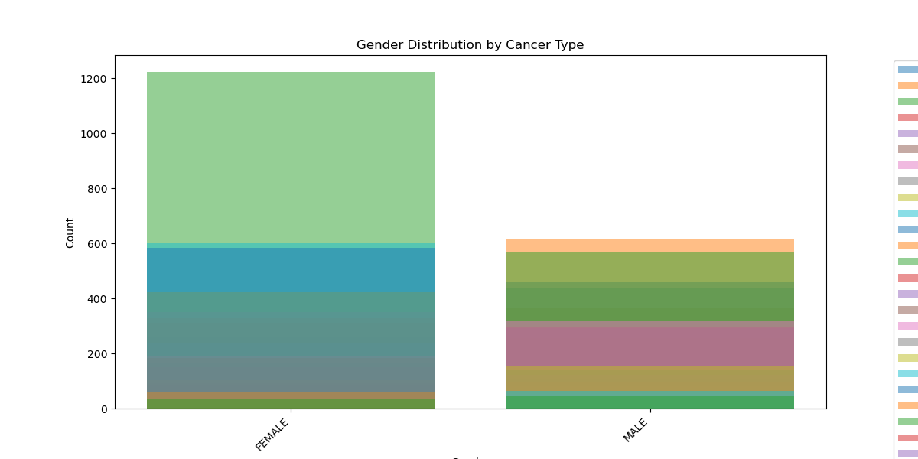
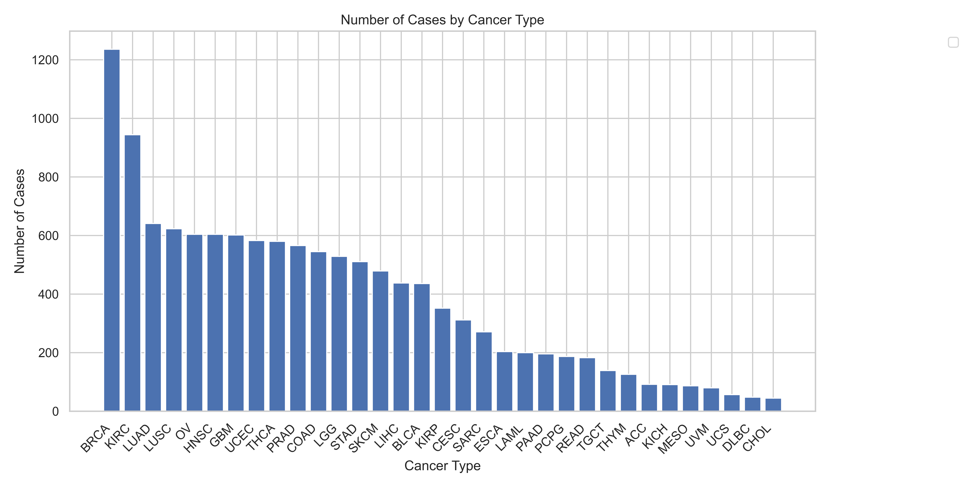
Dataset Observations

Slide 7
Single sample Gene Score Enrichment Analysis (ssGSEA)
Typical goal is to find genes significantly differentially correlated with distinct sample classes defined by a particular phenotype .
Gene Set Enrichment Analysis (GSEA) addressed the gene expression variation by evaluating whether a priori defined sets of genes, associated with particular biological processes (such as pathways), chromosomal locations, or experimental results are enriched at either the top or bottom of a list of differentially expressed genes ranked by some measure of differences in a gene’s expression across sample classes.[Subramanium et al. 2005]
Single-sample GSEA (ssGSEA), an extension of Gene Set Enrichment Analysis (GSEA), calculates separate enrichment scores for each pairing of a sample and gene set. Each ssGSEA enrichment score represents the degree to which the genes in a particular gene set are coordinately up- or down-regulated within a sample.
Where GSEA generates a gene set’s enrichment score with respect to phenotypic differences across a collection of samples within a dataset, ssGSEA calculates a separate enrichment score for each pairing of sample and gene set, independent of phenotype labeling.

Slide 8
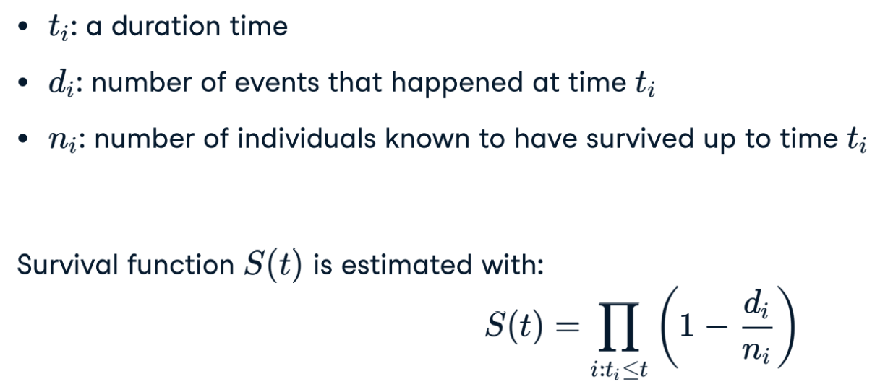
Kaplan-Meier Estimate

Slide 9
Statistical Methods
Single sample Gene Score Enrichment Analysis (ssGSEA)
KM Estimate
Cox Regression Model

Slide 10
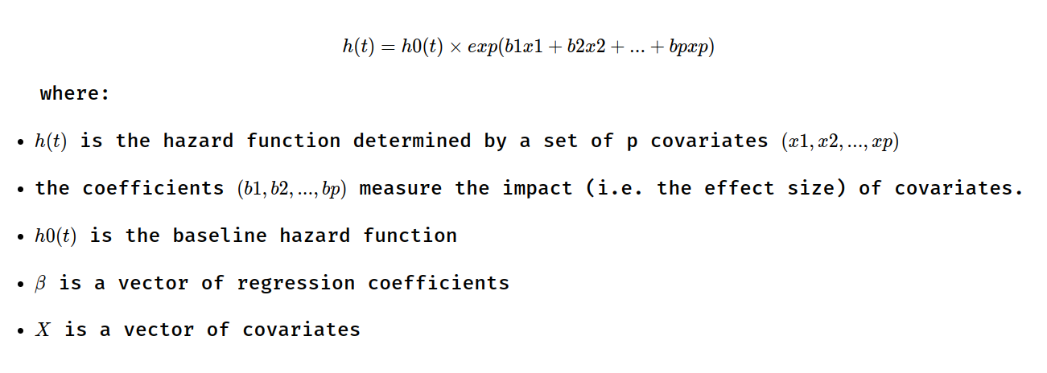
Cox Regression Model

Slide 11
Workflow
Based on EDA, identified top 6 cancer and perform following workflow for each cancer type.
Perform ssGSEA curated from [Vaske et. al 2010]
Identify top 3 regulated (up, down) pathways
Group patients into 7 groups (top 3 unregulated, top 3 down regulated, no regulation) based on pathways.
Perform Cox Regression
Identify most hazardous pathway amongst the previously identified pathways
Perform KM Estimation and get KM survival curves

Slide 12
Results - BRCA
Upregulated: Mtb_iron_assimilation_by_chelation and cumulative hazard is: 0.06375662797876425

Slide 13
Results - BRCA

Slide 14
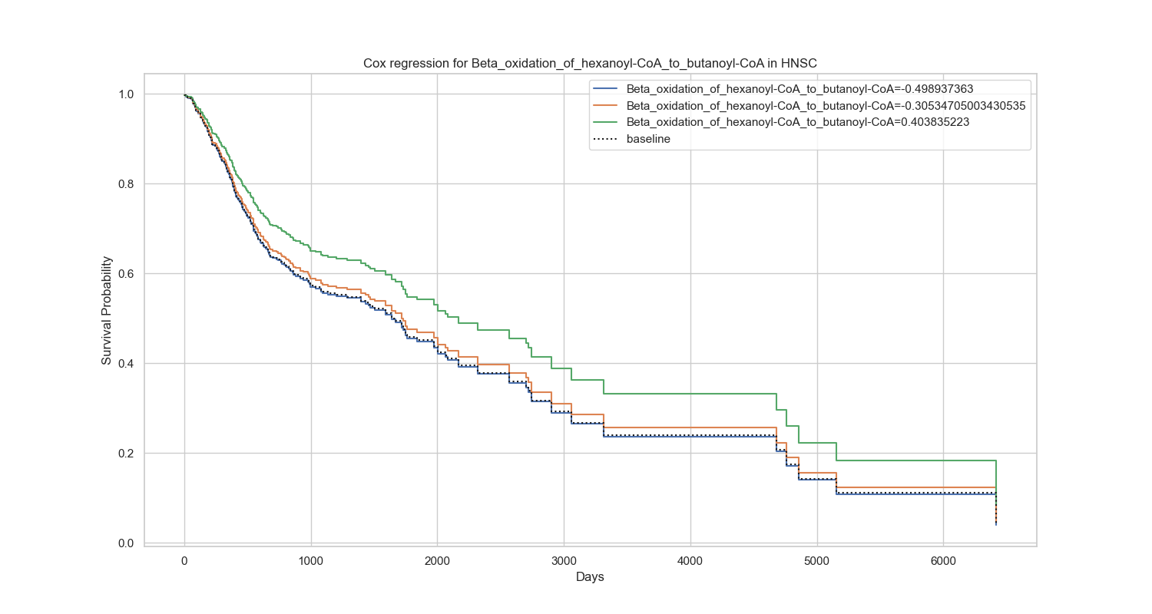
Results - HNSC
Downregulated: Beta_oxidation_of_hexanoyl-CoA_to_butanoyl-CoA and cumulative hazard is: 0.32253908004216814

Slide 15
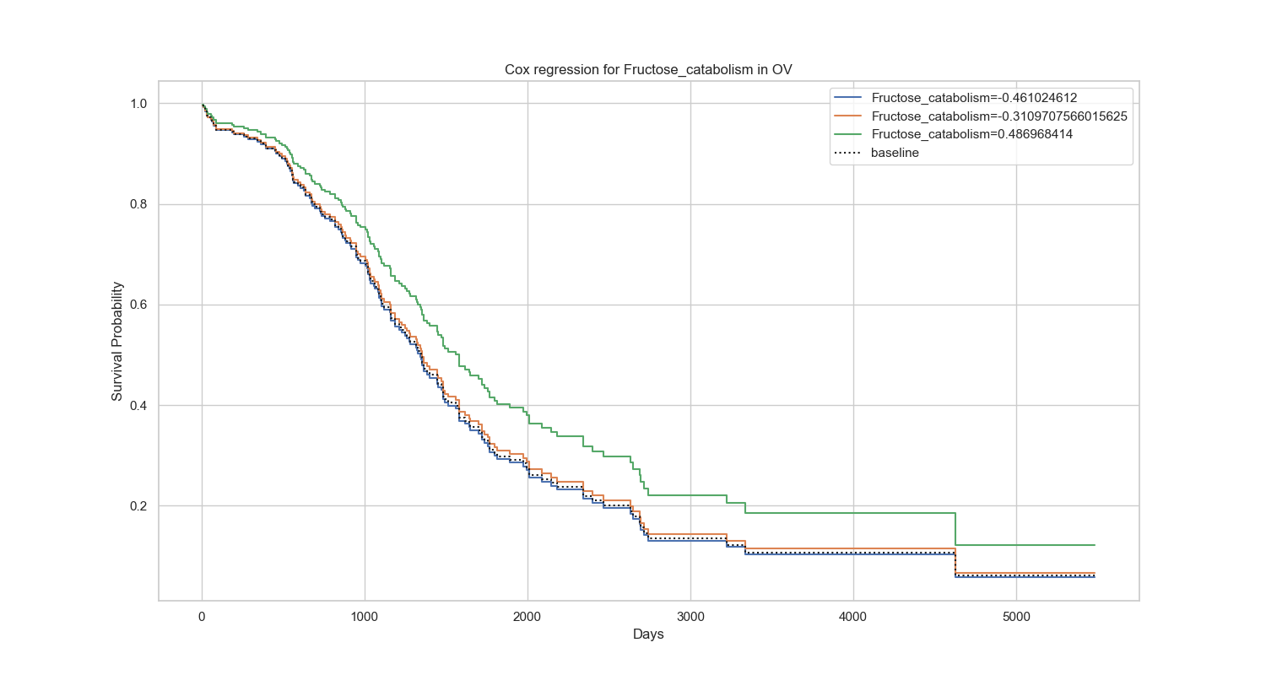
Results - OV
Downregulated: Fructose_catabolism and cumulative hazard is: 0.30975623926977625

Slide 16
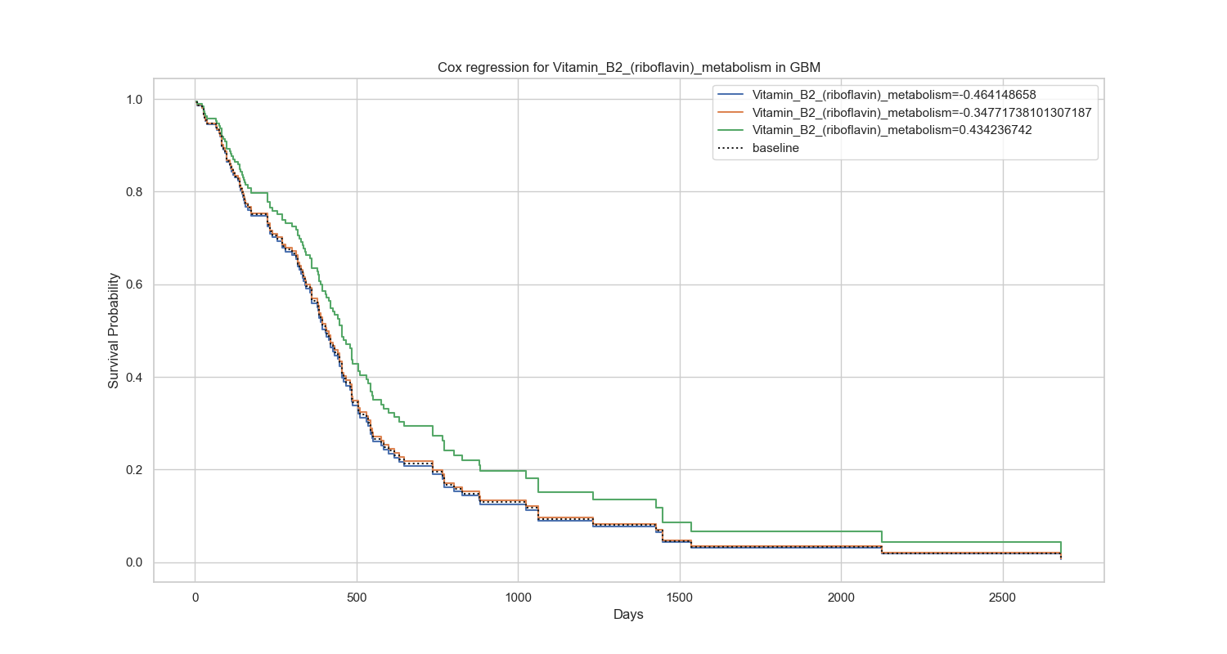
Results - GBM
Downregulated: Vitamin_B2_(riboflavin)_metabolism and cumulative hazard is: 0.403731163717974

Slide 17
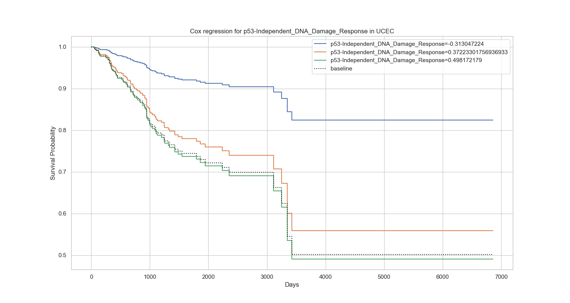
Results - UCEC
Upregulated: p53-Independent_DNA_Damage_Response and cumulative hazard is: 0.13397947146229183

Slide 18
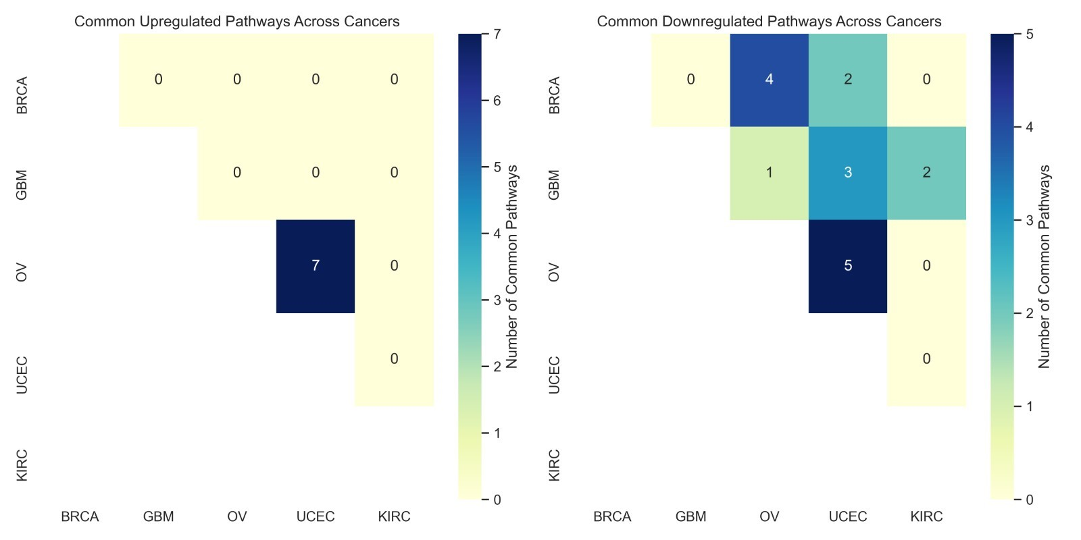
An interesting observation
We analysed the top 10 pathways for Ovarian cancer (OV) and uterine carcinosarcoma [UCEC] and interestingly found that they had very similar pathway upregulation and downregulation trends, which was unlike other cancer types.

Slide 19
An interesting observation
Most hazardous pathways: UCEC: Upregulated: p53-Independent_DNA_Damage_Response and cumulative hazard is: 0.13397947146229183 OV: Downregulated: Fructose_catabolism and cumulative hazard is: 0.30975623926977625
Despite the presence of similar upregulated and downregulated pathways in both cancers, the most hazardous pathways differed markedly in terms of functionality. Ovarian cancer exhibited heightened mortality risk associated with a metabolic pathway, while uterine cancer linked to a DNA repair pathway. This disparity highlights the nuanced impact of pathway irregularities on patient survival, even when similar pathways are dysregulated across distinct cancer types.

Slide 20
Conclusion
This study underscores the importance of considering cancer-specific nuances in pathway irregularities when developing targeted therapies.
The fact that similar pathways can yield different impacts on patient survival across cancer types emphasizes the need for precision oncology approaches.
As we delve deeper into the complexities of cellular signalling pathways, the integration of this knowledge into clinical practice holds great promise for improving patient outcomes.
Our findings contribute valuable insights to the ongoing efforts in advancing precision medicine and underscore the necessity of a nuanced, cancer-type-specific approach in the quest to enhance patient survival.

Slide 21
References
Cancer WHO
The Cancer Genome Atlas Program (TCGA)
ssGSEAProjection (v4)
GSEA Python Module
Liu J, Lichtenberg T, Hoadley KA, Poisson LM, Lazar AJ, Cherniack AD, Kovatich AJ, Benz CC, Levine DA, Lee AV, Omberg L, Wolf DM, Shriver CD, Thorsson V; Cancer Genome Atlas Research Network; Hu H. An Integrated TCGA Pan-Cancer Clinical Data Resource to Drive High-Quality Survival Outcome Analytics. Cell. 2018 Apr 5;173(2):400-416.e11. doi: 10.1016/j.cell.2018.02.052. PMID: 29625055; PMCID: PMC6066282.
Huang, X., Stern, D. & Zhao, H. Transcriptional Profiles from Paired Normal Samples Offer Complementary Information on Cancer Patient Survival – Evidence from TCGA Pan-Cancer Data. Sci Rep 6, 20567 (2016). https://doi.org/10.1038/srep20567
Ricketts CJ, De Cubas AA, Fan H, Smith CC, Lang M, Reznik E, Bowlby R, Gibb EA, Akbani R, Beroukhim R, Bottaro DP, Choueiri TK, Gibbs RA, Godwin AK, Haake S, Hakimi AA, Henske EP, Hsieh JJ, Ho TH, Kanchi RS, Krishnan B, Kwiatkowski DJ, Lui W, Merino MJ, Mills GB, Myers J, Nickerson ML, Reuter VE, Schmidt LS, Shelley CS, Shen H, Shuch B, Signoretti S, Srinivasan R, Tamboli P, Thomas G, Vincent BG, Vocke CD, Wheeler DA, Yang L, Kim WY, Robertson AG; Cancer Genome Atlas Research Network; Spellman PT, Rathmell WK, Linehan WM. The Cancer Genome Atlas Comprehensive Molecular Characterization of Renal Cell Carcinoma. Cell Rep. 2018 Apr 3;23(1):313-326.e5. doi: 10.1016/j.celrep.2018.03.075. Erratum in: Cell Rep. 2018 Jun 19;23(12):3698. PMID: 29617669; PMCID: PMC6075733.

